Slide 3
Beautiful Creator
Genesis 1:1-5

Slide 4
Big Idea: Because God is a beautiful creator, he only makes beautiful things

Slide 5
I. God created everything beautiful

Slide 6
Genesis 1:1-5
In the beginning God created the heavens and the earth. 2 Now the earth was formless and empty, darkness was over the surface of the deep, and the Spirit of God was hovering over the waters.

Slide 7
Genesis 1:1-5
3 And God said, “Let there be light,” and there was light. 4 God saw that the light was good, and he separated the light from the darkness. 5 God called the light “day,” and the darkness he called “night.” And there was evening, and there was morning—the first day.

Slide 8
The rhythm of creation
God said, “Let there be….”
And there was…
God saw that it was good.
God called it ______
There was evening and morning.

Slide 9
The rhythm of creation
God said, “Let there be….”
And there was…
God saw that it was good.
God called it ______
There was evening and morning.

Slide 10
Genesis 1:31
31 God saw all that he had made, and it was very good. And there was evening, and there was morning—the sixth day.

Slide 11
Genesis 1:31
31 God saw all that he had made, and it was very good. And there was evening, and there was morning—the sixth day.

Slide 12
Genesis 1:27
So God created humankind in his own
image,
in the image of God he created them;
male and female he created them.

Slide 13
Your creator thinks you’re beautiful. Do you agree with Him?

Slide 14
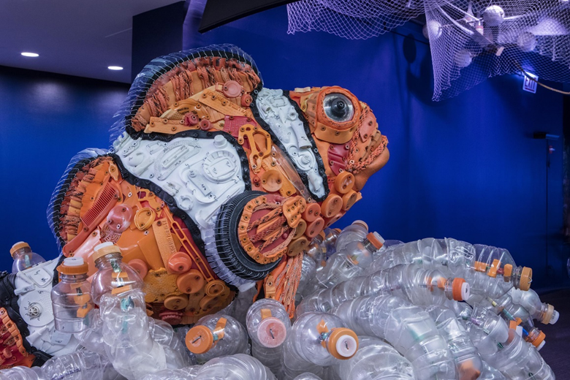

Slide 15
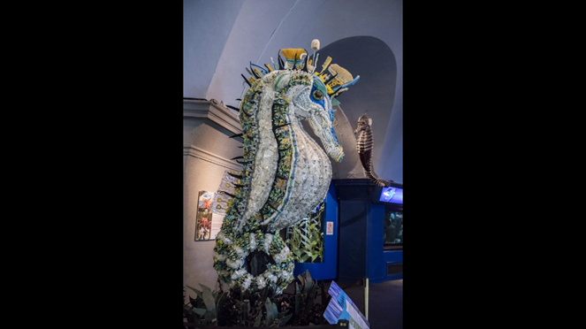

Slide 16
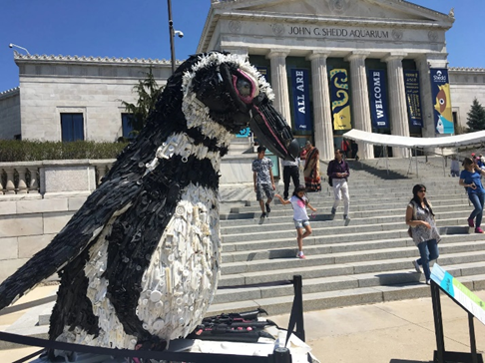

Slide 17
I. God created everything beautiful

Slide 18
Big Idea: Because God is a beautiful creator, he only makes beautiful things

Slide 19
II. Humans traded beauty for destruction

Slide 20
Genesis 6:12
12 God saw how corrupt the earth had become, for all the people on earth had corrupted their ways.

Slide 21
II. Humans traded beauty for destruction

Slide 22
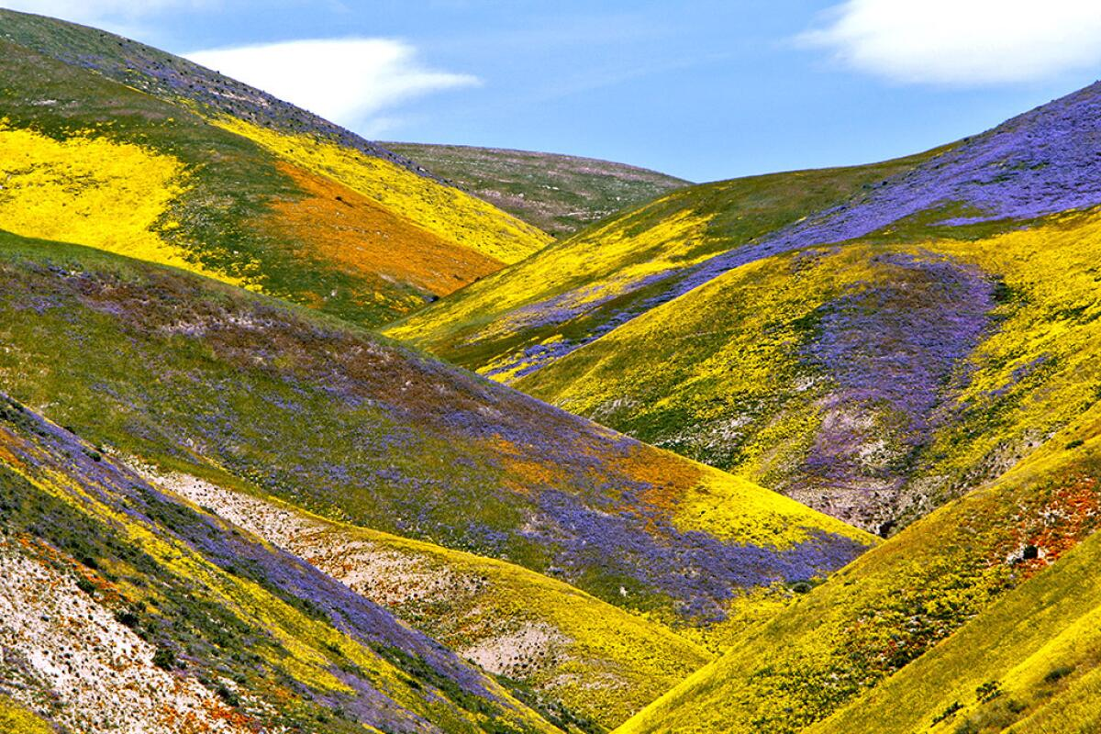

Slide 23
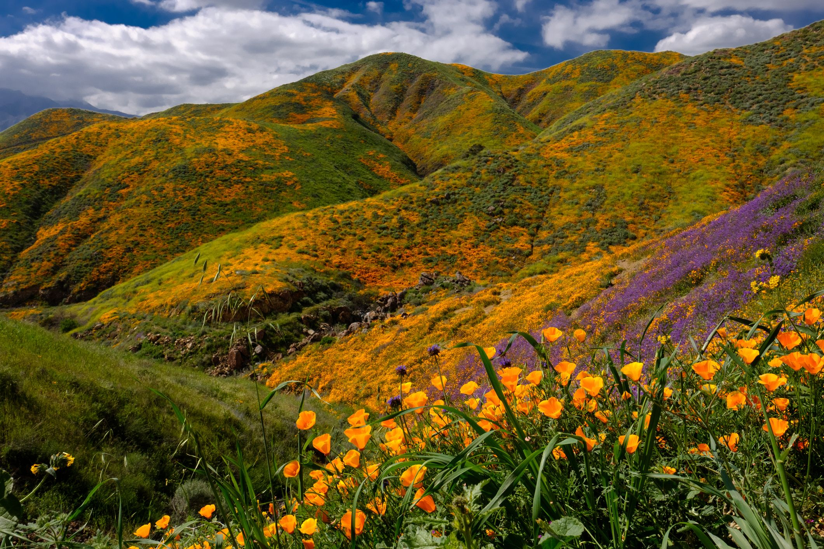

Slide 24
III. God is making all things beautiful again.

Slide 25
2 Corinthians 5:17-19
17 Therefore, if anyone is in Christ, the new creation has come: The old has gone, the new is here!

Slide 26
2 Corinthians 5:17-19
18 All this is from God, who reconciled us to himself through Christ and gave us the ministry of reconciliation: 19 that God was reconciling the world to himself in Christ, not counting people’s sins against them. And he has committed to us the message of reconciliation.

Slide 27
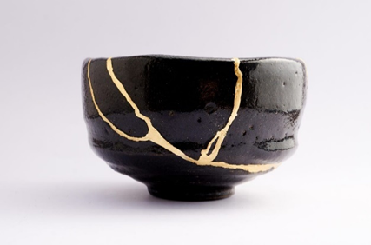

Slide 28
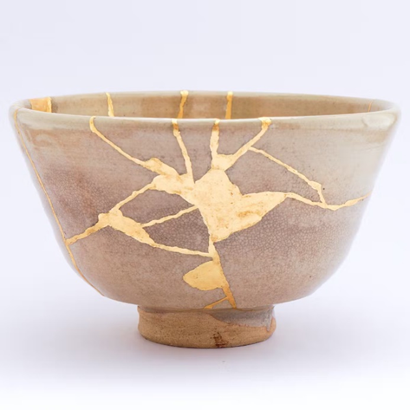

Slide 29
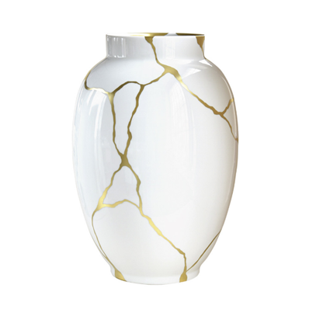

Slide 30
Big Idea: Because God is a beautiful creator, he only makes beautiful things

Slide 31
How do we live it out?

Slide 32
How do we live it out?
Love what is beautiful

Slide 33
How do we live it out?
Love what is beautiful
2. Create what is beautiful

Slide 34
How do we live it out?
Love what is beautiful
2. Create what is beautiful
3. Become what is beautiful

